Slide 1

Chapter 15
Connecting LANs,
Backbone Networks,
and Virtual LANs
15.<number>
Copyright © The McGraw-Hill Companies, Inc. Permission required for reproduction or display.

Slide 2
15-1 CONNECTING DEVICES
In this section, we divide connecting devices into five different categories based on the layer in which they operate in a network.
Topics discussed in this section:
Passive Hubs
Active Hubs
Bridges
Two-Layer Switches
Routers
Three-Layer Switches
Gateways
15.<number>

Slide 3

Figure 15.1 Five categories of connecting devices
15.<number>

Slide 4

Figure 15.2 A repeater connecting two segments of a LAN
15.<number>

Slide 5

Note
A repeater connects segments of a LAN.
15.<number>

Slide 6
Note
A repeater forwards every frame;
it has no filtering capability.
15.<number>

Slide 7
Note
A repeater is a regenerator,
not an amplifier.
15.<number>

Slide 8

Figure 15.3 Function of a repeater
15.<number>

Slide 9

Figure 15.4 A hierarchy of hubs
15.<number>

Slide 10
Note
A bridge has a table used in
filtering decisions.
15.<number>

Slide 11

Figure 15.5 A bridge connecting two LANs
15.<number>

Slide 12
Note
A bridge does not change the physical (MAC) addresses in a frame.
15.<number>

Slide 13

Figure 15.6 A learning bridge and the process of learning
15.<number>

Slide 14
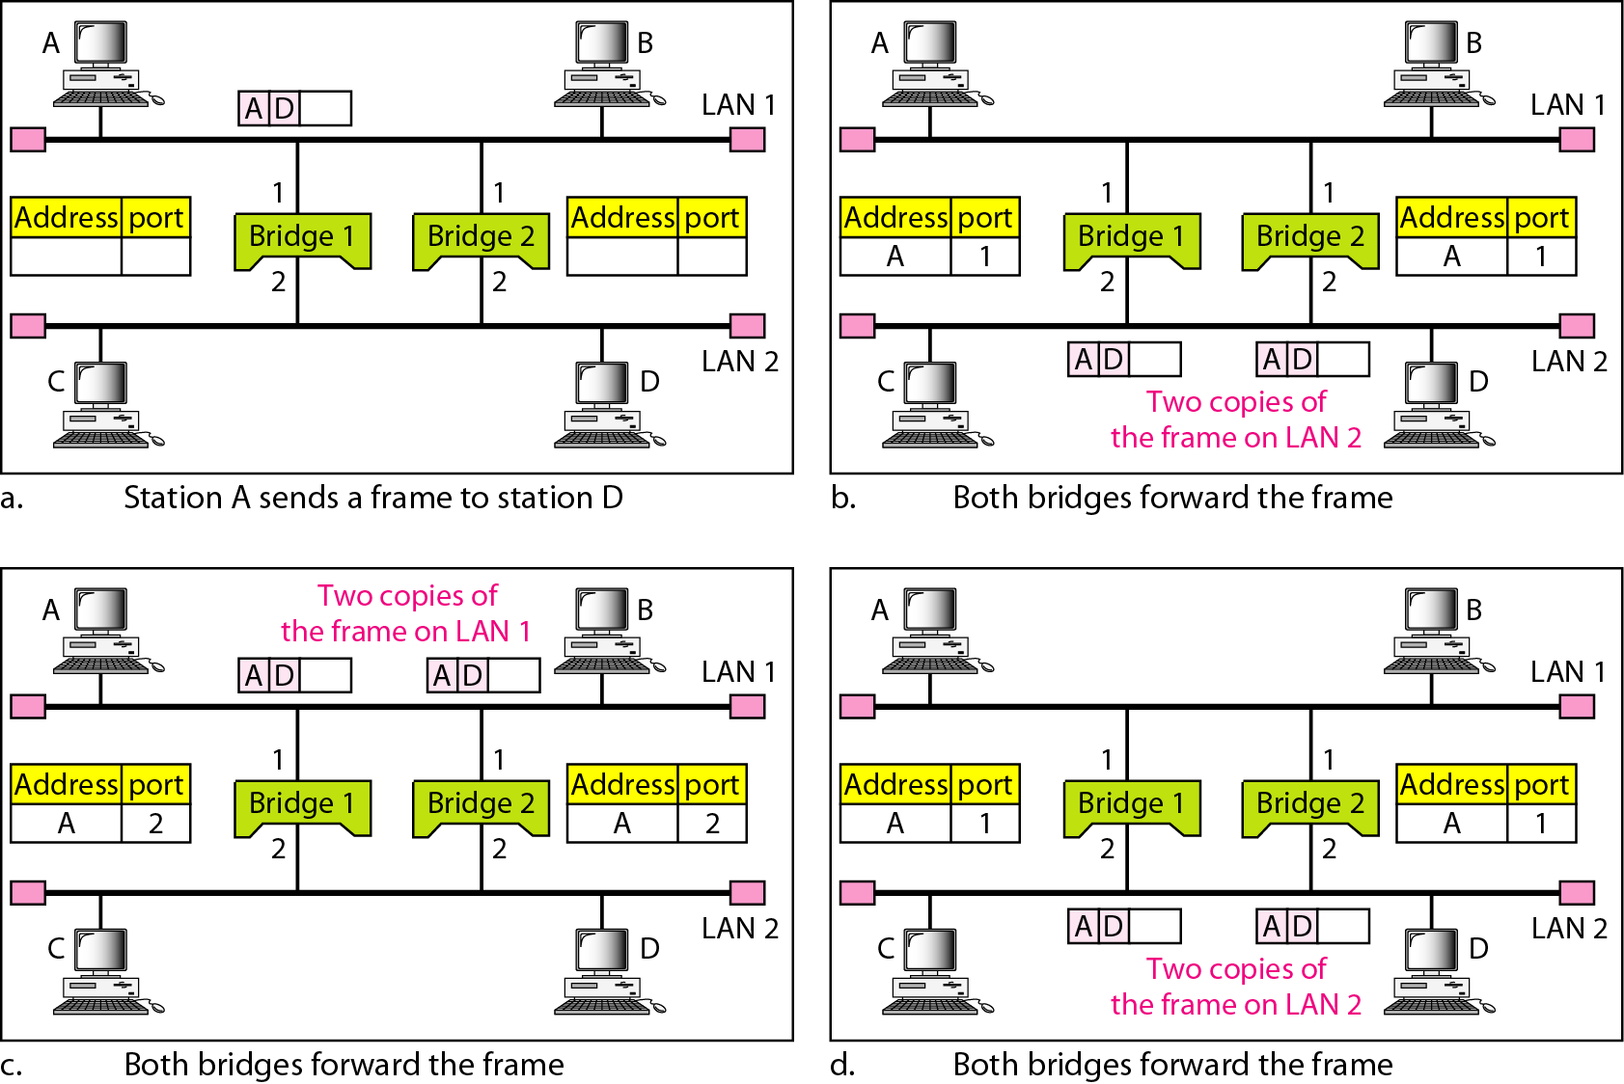
Figure 15.7 Loop problem in a learning bridge
15.<number>
Notes:
Figure 15.7 shows a very simple example of a loop created in a system with two LANs connected by two bridges.
1. Station A sends a frame to station D. The tables of both bridges are empty. Both forward the frame and update their tables based on the source address A.
2. Now there are two copies of the frame on LAN 2. The copy sent out by bridge 1 is received by bridge 2, which does not have any information about the destination address D; it floods the bridge. The copy sent out by bridge 2 is received by bridge 1 and is sent out for lack of information about D. Note that each frame is handled separately because bridges, as two nodes on a network sharing the medium, use an access method such as CSMA/CD. The tables of both bridges are updated, but still there is no information for destination D.
3. Now there are two copies of the frame on LAN 1. Step 2 is repeated, and both copies flood the network.
4. The process continues on and on. Note that bridges are also repeaters and regenerate frames. So in each iteration, there are newly generated fresh copies of the frames.
To solve the looping problem, the IEEE specification requires that bridges use the spanning tree algorithm to create a loopless topology.

Slide 15
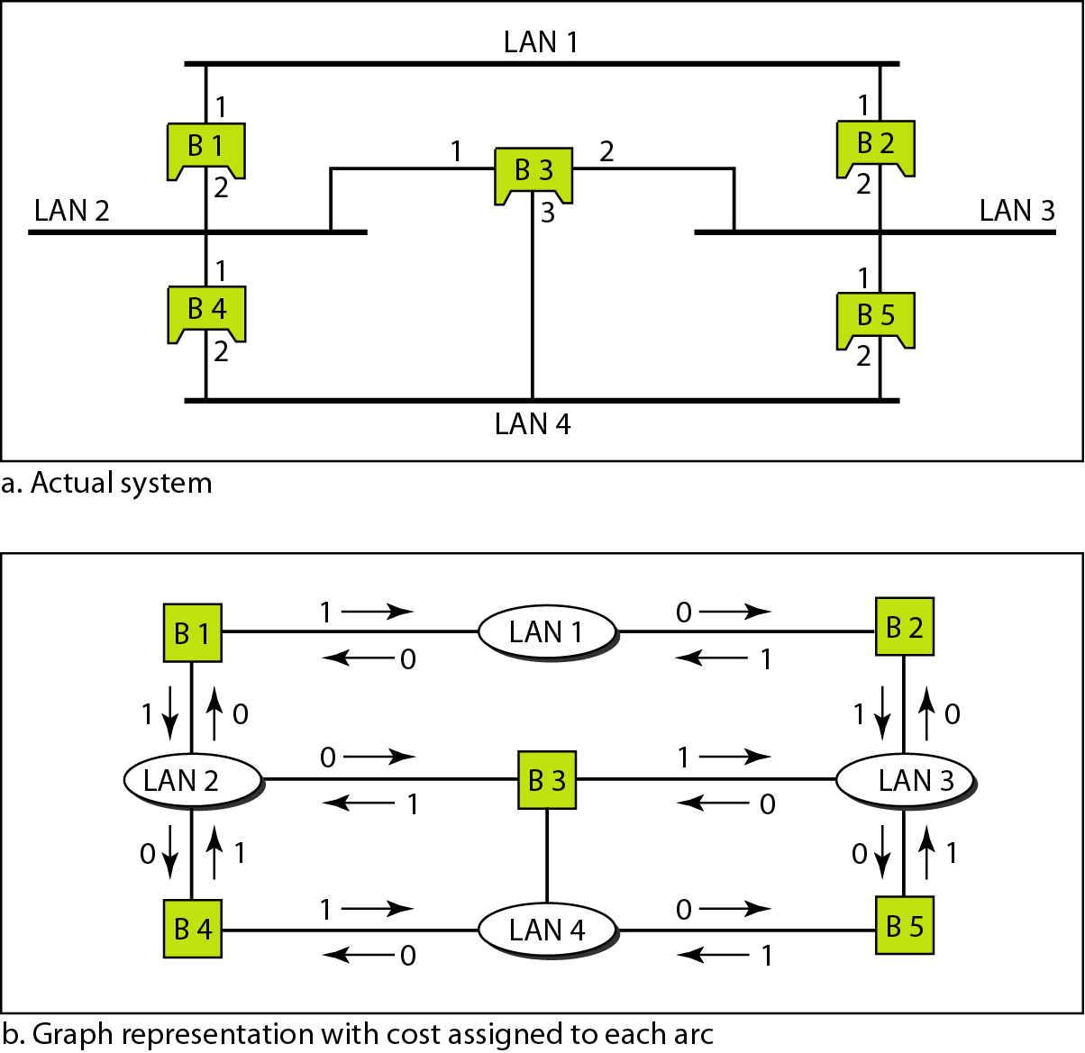
Figure 15.8 A system of connected LANs and its graph representation
15.<number>
Notes:
In graph theory, a spanning tree is a graph in which there is no loop. In a bridged LAN, this means creating a topology in which each LAN can be reached from any other LAN through one path only (no loop). We cannot change the physical topology of the system because of physical connections between cables and bridges, but we can create a logical topology that overlays the physical one.
To find the spanning tree, we need to assign a cost (metric) to each arc. The interpretation of the cost is left up to the systems administrator. It may be the path with minimum hops (nodes), the path with minimum delay, or the path with maximum bandwidth. If two ports have the same shortest value, the systems administrator just chooses one. We have chosen the minimum hops. However, as we will see in Chapter 22, the hop count is normally 1 from a bridge to the LAN and 0 in the reverse direction.

Slide 16
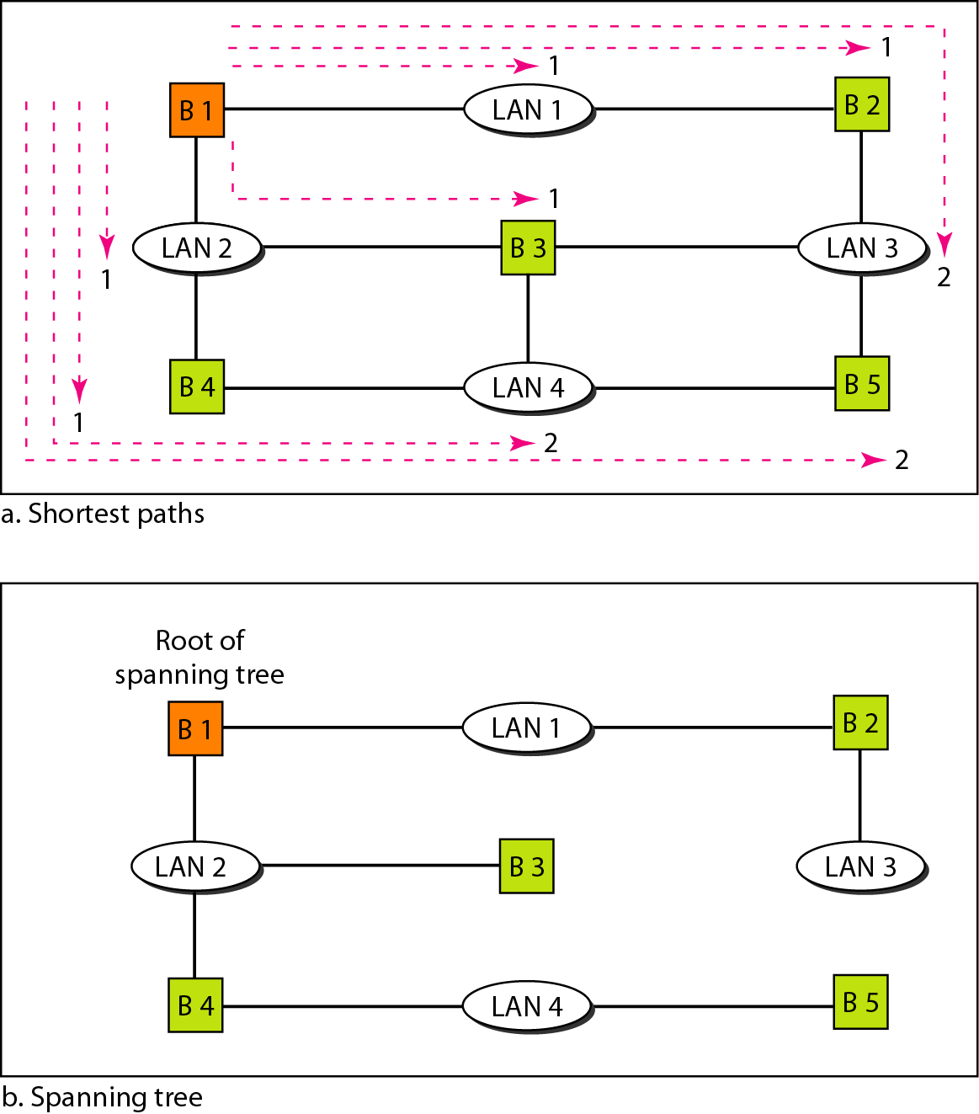
Figure 15.9 Finding the shortest paths and the spanning
tree in a system of bridges
15.<number>
Notes:
The process to find the spanning tree involves three steps:
1. Every bridge has a built-in ID (normally the serial number, which is unique). Each bridge broadcasts this ID so that all bridges know which one has the smallest ID. The bridge with the smallest ID is selected as the root bridge (root of the tree). We assume that bridge B1 has the smallest ID. It is, therefore, selected as the root bridge.
2. The algorithm tries to find the shortest path (a path with the shortest cost) from the root bridge to every other bridge or LAN. The shortest path can be found by examining the total cost from the root bridge to the destination. Figure 15.9 shows the shortest paths.
3. The combination of the shortest paths creates the shortest tree, which is also shown in Figure 15.9.
4. Based on the spanning tree, we mark the ports that are part of the spanning tree, the forwarding ports, which forward a frame that the bridge receives. We also mark those ports that are not part of the spanning tree, the blocking ports, which block the frames received by the bridge. Figure 15.10 shows the physical systems of LANs with forwarding points (solid lines) and blocking ports (broken lines). Each bridge is equipped with a software package that carries out this process dynamically. The bridges send special messages to one another, called bridge protocol data units (BPDUs), to update the spanning tree.

Slide 17
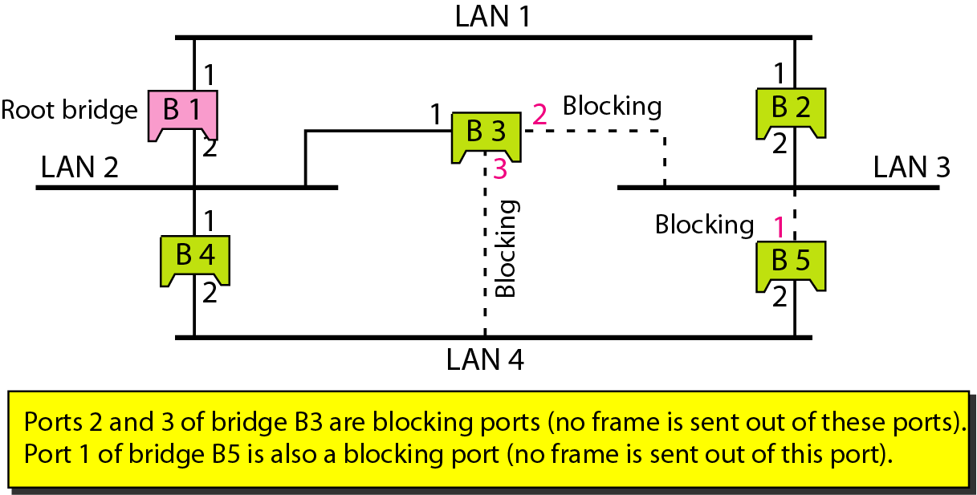
Figure 15.10 Forwarding and blocking ports after using spanning
tree algorithm
15.<number>

Slide 18

Figure 15.11 Routers connecting independent LANs and WANs
15.<number>

Slide 19
15-2 BACKBONE NETWORKS
A backbone network allows several LANs to be connected. In a backbone network, no station is directly connected to the backbone; the stations are part of a LAN, and the backbone connects the LANs.
Topics discussed in this section:
Bus Backbone
Star Backbone
Connecting Remote LANs
15.<number>

Slide 20
Note
In a bus backbone, the topology
of the backbone is a bus.
15.<number>

Slide 21
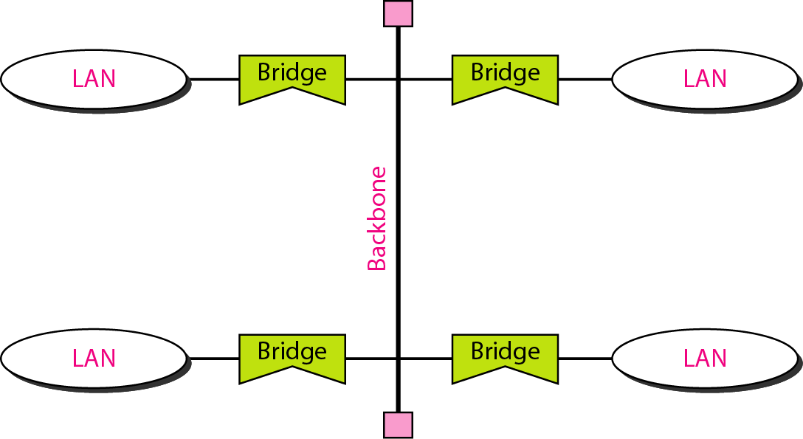
Figure 15.12 Bus backbone
15.<number>

Slide 22
Note
In a star backbone, the topology of the backbone is a star;
the backbone is just one switch.
15.<number>

Slide 23
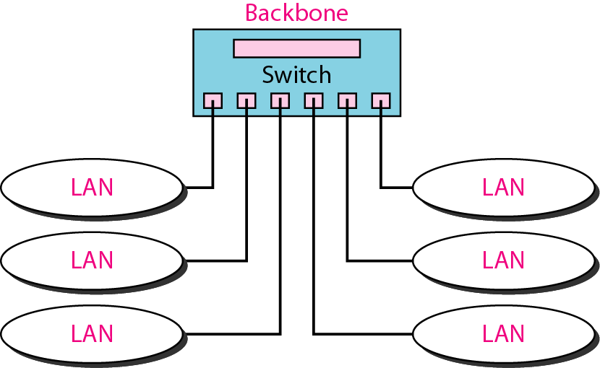
Figure 15.13 Star backbone
15.<number>

Slide 24
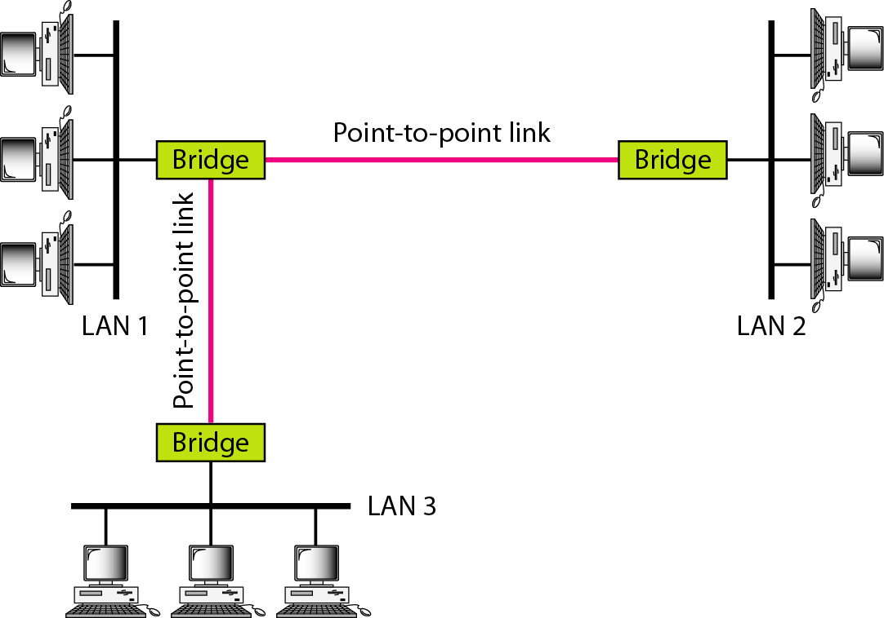
Figure 15.14 Connecting remote LANs with bridges
15.<number>

Slide 25
Note
A point-to-point link acts as a LAN in a remote backbone connected by
remote bridges.
15.<number>

Slide 26
15-3 VIRTUAL LANs
We can roughly define a virtual local area network (VLAN) as a local area network configured by software, not by physical wiring.
Topics discussed in this section:
Membership
Configuration
Communication between Switches
IEEE Standard
Advantages
15.<number>

Slide 27
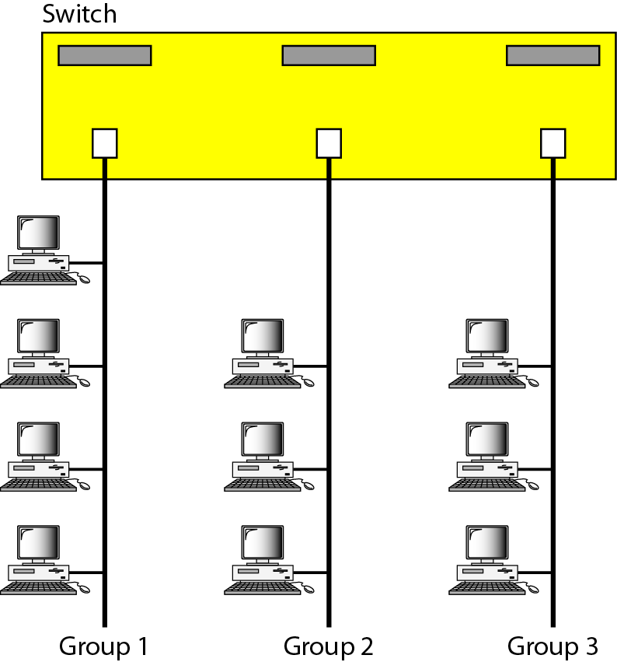
Figure 15.15 A switch connecting three LANs
15.<number>

Slide 28

Figure 15.16 A switch using VLAN software
15.<number>

Slide 29

Figure 15.17 Two switches in a backbone using VLAN software
15.<number>

Slide 30
Note
VLANs create broadcast domains.
15.<number>
Notes:
There are several advantages to using VLANs.
Cost and Time Reduction
VLANs can reduce the migration cost of stations going from one group to another. Physical reconfiguration takes time and is costly. Instead of physically moving one station to another segment or even to another switch, it is much easier and quicker to move it by using software.
Creating Virtual Work Groups
VLANs can be used to create virtual work groups. For example, in a campus environment, professors working on the same project can send broadcast messages to one another without the necessity of belonging to the same department. This can reduce traffic if the multicasting capability of IP was previously used.
Security
VLANs provide an extra measure of security. People belonging to the same group can send broadcast messages with the guaranteed assurance that users in other groups will not receive these messages.

